Slide 2
INDEX
1 CSC Introduction
1.1 Vision & Mission of CSC SPV
1.2 Objectives of CSC SPV
2 CSC Institutional Structure
3 CSC SPV Technology Plaform – DIGITAL SEVA
4 CSC’s Services Catalogue
4.1 Digi Pay (AePS)
4.2 Insurance
4.3 Banking
4.4 Pension
4.5 Aadhaar Services
4.6 UCL
4.7 Digital Seva Kendra(DSK)
4.8 UJALA
4.9 LED MMU
4.10 Sanitary Napkins
4.11 Railway Ticketing (IRCTC)
4.12 Passport Applications
4.13 Education
4.14 Health Care Services
4.15 Skill Development
4.16 CSC VLE Bazaar
4.17 GST
4.18 Electricity Bill Payment
4.19 Election
4.2 Wifi Choupal
4.21 New Services
4.22 Helpdesk and Ticket Generation

Slide 3
1. CSC Introduction
I. Common Services Centers (CSCs) are a strategic cornerstone of the Digital India programme. CSCs are envisaged as assisted front-end ICT (Information and Communication Technology) enabled centres for delivery of various G2C (Government to Citizen) and other B2C (Business to Citizen) services to the citizens. These are managed and operated by local skilled enterpreneurs. The service portfolio, including G2C services, enable a sustainable rural enterprise providing employment opportunities to local poplulation.
II. CSC e-Governance Services India Limited is a Special Purpose Vehicle (CSC SPV) incorporated under the Companies Act, 1956 by the Ministry of Electronics and Information Technology (MeitY), Government of India, to interalia monitor the implementation of the Common Services Centers Scheme. It provides a centralized collaborative framework for delivery of services to citizens through CSCs, besides ensuring systemic viability and sustainability of the scheme.
III. The focus of this programme is to bring transformation to relaize IT (India Talent) + IT (Information Technology) = IT (India Tomorrow).
IV. From the learnings of implemetation of CSC Scheme, government launched the CSC Scheme as CSC 2.0 to achive its vision of delivering various servcies to citizens at Gram Panchayat level. The vision of CSC 2.0 is ‘One Panchayat, One CSC’. It envisages establishment of 2.5 lakh CSCs covering all Gram Panchayats in the country to provide e-services to citizens. CSC 2.0 aims to further improve the availability and accessibility of services to the rural population.

Slide 4
CSCs today are prescribed as one of the service delivery points in rural India. They are positioned as change agents, promoting rural entrepreneurship and building rural capacities and livelihoods. They focus towards the digital development, catayzing rural enterpreneurs & social inclusion.

Slide 5
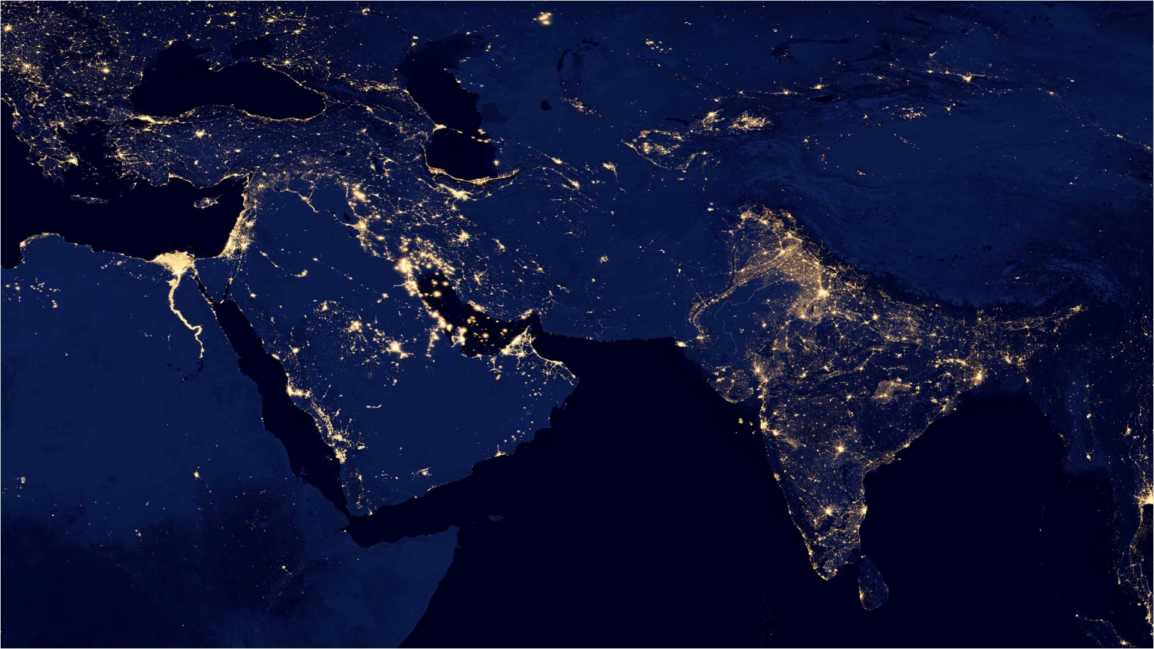
1.1 Vision & Mission of CSC SPV
To develop CSCs as a dependable, reliable and ubiquitous IT enabled network of Citizen Service Points connecting local population with the Government departments, business establishments, banks , insurance companies and educational institutions, with an impact on primary, secondary and tertiary sectors of the country’s economy.
The mission of CSC SPV is to enable provision of government, private and social sector services to citizens at doorsteps, at affordable cost and in a transparent manner through the CSCs.

Slide 6
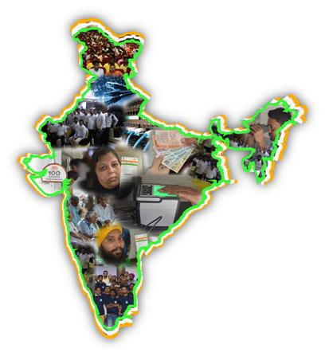
1.2 Objectives of CSC SPV
I. Ensuring systemic viability and sustainability of the CSC Scheme.
II. Expanding the scope of delivery of G2C & B2C services to rural citizens.
III. Expanding access to larger market for rural population.
IV. Providing a standardized framework for collaborative decision making.
V. Catalyzing and maintaining content aggregation on an on-going basis.
VI. Non-discriminatory access to e-Services to rural citizens by making the CSCs complete service delivery centres, utilizing the backend infrastructure already available with other Govt departments /agencies.
VII. Expansion of self-sustaining CSC network till Gram Panchayat level - 2.5 Lakhs CSCs i.e. at least one CSC per Gram Panchayat.
VIII. Strengthening the institutional framework for the rollout and project management, thereby, supporting the State and District administrative machinery and handholding of the VLEs through local language Help Desk support.
IX. Encouraging women as VLEs.
X. Making the entire network neutral for all service providers (no exclusivity) integrated to market and sell products and services in Rural India.
XI. Building stakeholder capacity.

Slide 7
2. CSC Institutional Structure

Slide 8
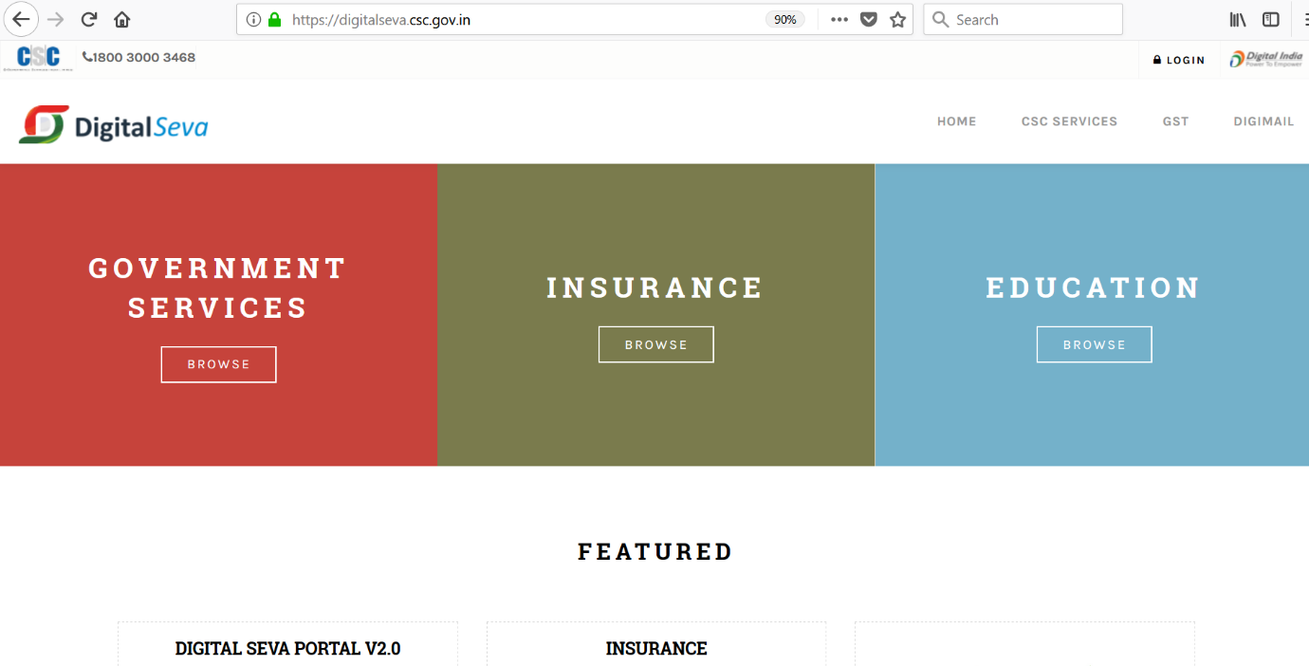
3. CSC SPV Technology Plaform – DIGITAL SEVA
i. In order to optimize the design, development, deployment, update and access service delivery, CSC SPV developed a central portal called “DIGITAL SEVA”.
ii. The Portal has a secure pre-paid cash management system for VLEs, who manage the same using internet banking, mobile banking (IMPS), and credit/debit card.
iii. As per the vision of CSC 2.0 to enhance & strengthen the CSC network, CSC SPV has launched the new technology platform - digitalseva.csc.gov.in - with advance security features. This platform is the backbone of the entire CSC network.
iv. Approximately 1.5 crore transactions happen per month through this platform.

Slide 9
4. CSC’s Services Catalogue
I. CSC SPV offers number of services to VLEs to make their CSC centre financially viable. The services include G2C and B2C services, financial inclusion and educational services. The company continuously strives to identify and add new services to enhance the service spectrum/portfolio.
II. G2C Services: Delivery of Government service through the CSCs is driven by the Government, both Central and State. There has been significant variation in the delivery of G2C services with some States as Andhra Pradesh, Madhya Pradesh, Kerala, Rajasthan, Odisha, Haryana and Gujarat performing very well; while in other cases it shall improve with the implementation of the e-District scheme. It is true that with the implementation of e- District across the country, there shall be significant improvement in the delivery of G2C services to citizen through CSCs. CSC is also developing common application portal for Odisha with the concept of a single platform for all G2C services.
III. The citizen needs services other than G2C services to actively participate in nation building. CSCs meet the requirement of the citizen in enabling him to get information, knowledge and skills for overall development. Such services are enabled by the CSC SPV.

Slide 10
The list of CSC service catalogue is as follows;
S No | Service Name
1. | Digi Pay – AePS
2. | Insurance
3. | Banking
4. | Pension
5. | Aadaar Services
6. | UCL
7. | Digital Seva Kendra(DSK)
8. | UJALA
9. | LED MMU
10. | Sanitary Napkins
11. | Railway Ticketing (IRCTC)
S No | Service Name
12. | Passport Applications
13. | Education
14. | Health Care Services
15. | Skill Development
16. | CSC VLE Bazaar
17. | GST
18. | Electricity Bill Payment
19. | Election
20. | WiFiChoupal
21. | New Services
22. | Helpdesk and Ticket Generation

Slide 11
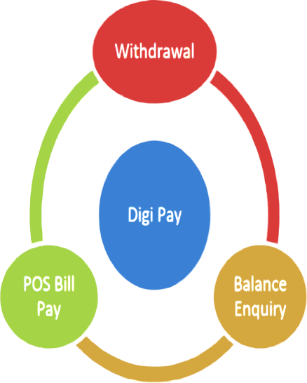
4.1 Digi Pay (AePS)
CSC SPV in collaboration with NPCI has launched Aadhaar Enabled Payment System (AePS) at all CSC locations across the country. This system is based on Aadhaar authentication of an individual, which reduces the threat of fraud and malicious activities. Aadhaar will facilitate 'anytime, anywhere’ authentication to its beneficiary.
The purpose is to achieve inter-operability between banks for Aadhaar-based payment transactions.
The Digi Pay application will enable CSCs to cater to the need of financial services in far flung and areas deprived of basic banking facilities in the country.
VLEs can also leverage on the footfall at their centre and play a vital role in making a cashless society as per the vision of Government.

Slide 12
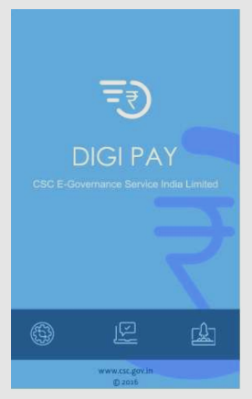
Video Guide:
Commision Structure: https://www.youtube.com/watch?v=Gwo9iss7F_Y#action=share
Submit your Complaint: https://www.youtube.com/watch?v=fghG9JHcnB4
Other Videos: http://www.netsamadhan.in/search?q=digipay or
https://www.youtube.com/watch?v=E6Rox0f3kZE
Manual Guide:
http://register.csccloud.in/digipay/
Point of Contact
Name | Designation | Email Id | Contact
Udit Sharma | Executive |  | 9650585458
Vinay Tosh Krishnatray | Executive | vinay.krishnatray@csc.gov.in | 9990875646
Vishal Agarwal | Executive | vishal.agarwal@csc.gov.in | 9999089074
ApoorvaAnand | Senior Executive | apoorva.anand@csc.gov.in | 9716456556
UdayMitra | Manager | uday.mitra@nic.in | 9978233588
Krishna Kumar Singh | HOD | krishna@cscegovindia.com | 9818400465

Slide 13
4.2 Insurance
CSC SPV obtain license from the Insurance Regulatory and Development Authority (IRDA) in 2013 to work as an authorized intermediary to market life and non-life insurance products through the Rural Authorized Persons, i.e. the VLEs. CSCs started offering General, Health and Life Insurance policies to the people living in rural areas on India.
Collection of Renewal Premium: CSCs across the country can also collect insurance premium towards renewal of life insurance policies.
RAP REGISTRATION PROCESS
All VLE’s can register for RAP Insurance service through Digital Seva Portal. The URL to register for this service and appear for the IRDAI exam is http://13.126.173.165/insurance/

Slide 14
Process flow depicts the life cycle of becoming a RAP from VLE.
The registration and licensing fee is Rs 350 for the first attempt.
A VLE can reappear for exam by paying a fee of Rs 175, if they are unable to clear their exam in first attempt.
The training modules are available in English, Hindi, Gujarati and Bengali. We are in process of adding modules in more regional languages.
The examination can be given in English, Hindi, Gujarati and Bengali language from Mon-Friday between 10 AM to 4PM (excluding Saturday, Sunday & Gazetted holidays).
The time of exam is of one hour duration which comes in Multiple Choice Questions.
A laptop/desktop with internet connection and web camera are required to attempt the exam.
OPEN VLE RAP REGISTRATION OPTION
COMPLETE AND SUBMIT THE FORM USING EKYC
MAKE FEE PAYMENT TOWARDS LICENSING AND EXAMINATION
STUDY THE TRAINING MODULES AND COMPLETE ASSIGMENTS
APPEAR FOR ONLINE EXAMINATION
VLE BECOMES LICENSED RAP AFTER PASSING THE EXAM
RAP STARTS ISSUING POLICIES

Slide 15
POLICY SOURCING
Once a VLE becomes licensed RAP, Insurance service will be enabled on Digital Seva Portal.
A RAP can sell the following Insurance products through CSC Digital Seva Portal.
PRODUCT | DETAILS | COMMISSION
Life Insurance | Term & Variable Insurance Plan | 5% of Premium
Life Insurance | KHATA – Single Premium Plan | 8.5% of the Premium
Motor Insurance | Third Party (Liability) Insurance | Rs 50 Per Policy
Motor Insurance | Motor Package Policy(First Party) | 10% of the Own Damage Premium
Personal Accidental Insurance |  | 15% of the Premium
Health Insurance | Insurance for Individual & entire family | 15% of the Premium
Pradhan Mantri Fasal Bima Yojana (Non Loanee Farmers) | Kharib & Rabi Season Crop Insurance | Rs 30 per Application
Fire and Allied Perils | Protection against loss or damage to property due to fire or perils | 10% of the Premium
Farmer Package Policy | Covers both the personal assets of the farmer and also the assets which help him in earning his livelihood. | 15% of the Premium
Agriculture Pump Set Insurance | Provides cover for Centrifugal Pump Sets and submersible pump sets used for agricultural purposes only. | 15% of the Premium
Cattle Insurance | Insurance of Mitch Cows, Goats etc | 15% of the Premium

Slide 16
**The commission will be given on the Premium, excluding Taxes**
• A VLE earns 80% of commission rate mentioned in above table.
• VLE gets instant commission for the policy sold and they also get amount of policy page at Rs. 5 (taxes inclusive) per page.
• Policy will be issued & handed over to the Customer instantly.
Video Guide:
https://www.youtube.com/results?search_query=csc+insurance+Net+samadhan
https://www.youtube.com/watch?v=lfATH9EdkC8
https://www.youtube.com/watch?v=4Q-hKntbLFc&feature=youtu.be
Point of Contact:
Name | Designation | Email Id | Contact
Hemant Ivaturi | Assistant Manager | Hemant@csc.gov.in | 9958656111
RiteshCharan | Senior Executive | Ritesh.charan@csc.gov.in | 9953332115
Hitesh Rana | Sr. Manager | Hitesh.rana@csc.gov.in | 9911144445
Riaz Mohammed | HOD | Riaz.mohd@nic.in | 9911176980

Slide 17
4.3 Banking
Financial Inclusion in India
In the last couple of years, India has witnessed important developments that have significantly impacted the delivery of financial inclusion (FI) services right up to the grassroots. The term "financial inclusion" has gained momentum in past few years, as a result of findings about 'financial exclusion and its direct correlation to poverty'. With that, achieving FI became a common objective for many central banks and Governments among the developing nations.
In India, the big push came on April 26, 2010, when Reserve Bank of India (RBI), as part of its FI mandate issued guidelines to Banks for delivery of financial services through the Common Services Centres (CSCs). The RBI in its Annual Policy Statement for the year 2010-11, allowed banks to engage companies (excluding Non Banking Financial Companies (NBFCs) registered under the Indian Companies Act, 1956, as Business Correspondents (BCs) in addition to individuals/entities permitted earlier. Further, the RBI allowed banks to engage the Common Service Centres' Operators / Village Level Entrepreneurs as BCs.
Further, February 15, 2011 was another landmark day, as “Swabhiman” Scheme was formally launched. The objective of the Scheme is to "make banking facility available to all citizens". Besides this, Department of Financial Services, Government of India issued instructions to Banks to appoint CSC as the Business Correspondent. Specifically, these initiatives and some other related developments set in motion the financial inclusion agenda in the country.

Slide 18
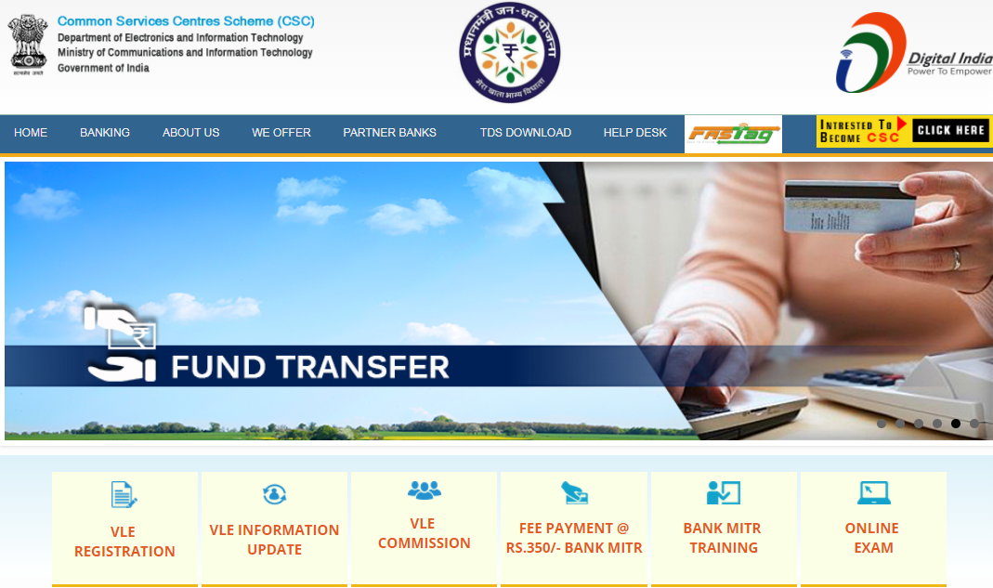
Registration Process for “BANK MITR EXAM”:
All VLE’s can register for Bank Mitr through Digital Seva Portal. The URL to register for this service and appear for exam is http://164.100.115.10/banking/
The below process flow depicts the life cycle of becoming “BANK MITR” from VLE.

Slide 19
Commission:
Initial implementations indicated that when banking is linked with disbursement of rural Government scheme benefits and wages, a BC can earn a minimum of Rs. 3000 per month, per CSP. Currently many VLEs are earning more than Rs. 20, 000 per month.
Video Guide:
How to register Bank Mitra
https://www.youtube.com/watch?v=MniZokBSNr8&feature=youtu.be
https://www.youtube.com/watch?v=GIH7EvdWK1s
https://www.youtube.com/watch?v=ZvTatWZtRKQ
Point of Contact:
Name | Designation | Email Id | Contact
Nidhi Pal | Executive | nidhi.pal19@nic.in | 9582695483
Gaurav Sharma | Executive | gaurav.sharma88@nic.in | 8802771616
Naveen Kumar | Executive | naveen.kr@csc.gov.in | 9891681743
SatybratNayak | Executive | satyabrat.nayak@csc.gov.in | 9953535298
Gaurav Yadav | Executive | Gaurav.yadav@csc.gov.in | 9990066051
Ashutosh Singh | Senior Executive | ashutosh@csc.gov.in | 9990087948
Anuj Tayal | Senior Executive | anuj.tayal@csc.gov.in | 9717819008
VidhiDiwakar | Manager | vidhi.diwakar@csc.gov.in | 9958003909
Harish Oberoi | Manager | harish.oberoi@csc.gov.in | 9971382233
Riaz Mohammed | HOD | Riaz.mohd@nic.in | 9911176980

Slide 20
4.4 Pension
National Pension System (NPS) is a contributory pension scheme which is highly efficient, technology driven system to save small amounts today, to build a fund for life’s second innings.
Who Can Join ?
You can join, if you are any or all of the following:
• Citizen of India; Resident or Non-Resident
• Age between 18-65 years, as on date of joining
• Salaried or Self Employed
• Complies with KYC norms

Slide 21
Through CSC Individual can contribute for retirement into this restricted-withdrawal account.
Contribution + Investment Growth – Charges = Accumulated Pension Wealth
Particulars | Tier I
Option of selection of the Account | Mandatory
Withdrawal Facility Available | Conditional & Restricted Withdrawal
Minimum Contribution at the time of A/c opening | Rs. 500
Minimum amount of subsequent contribution | Rs. 500
Minimum Contribution Required per year | Rs. 1000
Minimum no. of contribution per year | One
Frequency of contribution permitted | Unlimited

Slide 22
Subscriber Registration
Vle to select National Pension Scheme (NPS) Service under Financial Inclusion on the https://digitalseva.csc.gov.in Portal.
Put Aadhaar Number of Subscriber and run the authentication process
Vle need to facilitate the customer to fill the form Carefully.
Subscriber need to fill the details of nominee. If nominee is minor then guardian details are also required. After filling the nominee details kindly click on Add tab so that details are successfully uploaded.
Subscriber can select maximum 3 Nominee.
Upload Subscriber Signature- Upload image with extension jpg or png or jpeg and maximum allowed size is 12kb
After finishing vle can pay the amount from the wallet and provide the receipt to subscriber.
VLE to send the Physical copy of the Subscriber form to the address mentioned in the footer of the form. Subhash Rana, M/s Alankit Assignments Limited, Alankit House, 4E/2, Jhandewalan Extension, New Delhi 110005"

Slide 23
Additional Contribution
Charge Head | VLE Service Charge(Instant)
Initial Subscriber Registration | Rs. 100
Initial Contribution | Rs. 16 (Minimum)
All Subsequent Contribution

Slide 24
Video Guide:
Cash Deposit - https://youtu.be/VXFoU3VeTMg
https://www.youtube.com/watch?v=pn2DMu9fFwU
https://www.youtube.com/watch?v=5fXHqazeD-o
Point of Contact:
Name | Designation | Email Id | Contact
Deepak Singh Rana | Senior Executive | deepaks.rana@csc.gov.in | 9818221845

Slide 25
4.5 Aadhaar Services
Aadhaar is a 12 digit individual identification number issued by the Unique Identification Authority of India on behalf of the Government of India. This number serves as a proof of identity and address, anywhere in India. Aadhaar letter received via India Post and e-Aadhaar downloaded from UIDAI website are equally valid. Any individual, irrespective of age and gender, who is a resident in India and satisfies the verification process laid down by the UIDAI, can enrol for Aadhaar.
Each individual needs to enrol only once which is free of cost.
Each Aadhaar number will be unique to an individual and will remain valid for life. Aadhaar number will help you provide access to services like banking, mobile phone connections and other Government and non-Government services in due course.
Benefits of UID (Aadhaar)
Bank Account Opening
PAN Card
Passport
Mobile Number
Railway/Bus/Flight Reservation
Gas connection
Jeevan Praman

Slide 26
Services being offered through Aadhaar:
Aadhaar number is expected to provide access to a host of services like banking, mobile phone connections, driving license and other Government and non-Government services in due course. This number is expected to serve as a proof of identity and address, anywhere in India.
VLEs of CSC SPV can avail the delivery of Aadhaar Services through its Common Service Centres by registering himself / herself with CSC SPV and his/her centre will be known as Aadhaar Permanent Enrolment Centres (PEC).
Video Guide:
Biometric Exception Enrolments. http://youtu.be/7pybzLqD2G4
Biometric Updationhttp://youtu.be/PKzvbvWwOmU
UID Correction within 96 Hours http://youtu.be/bXantqhds7w
Demographic Updatehttp://youtu.be/qeh7pMr5Tq4
DMS Pick uphttp://youtu.be/XKClBW48TQg
E-Aadhaarhttp://youtu.be/5SQudakZnOQ
EOD Report http://youtu.be/06MxEn61cI8
End of Day review by Supervisors http://youtu.be/06MxEn61cI8
Force Capture http://youtu.be/J0dnvHGE6Y0
Head of Family based enrolments http://youtu.be/QeYRC6nbQSQ
Packet Sync and Export http://youtu.be/VisIHzLq-JM
POI and POA http://youtu.be/OaF7tMJxMxY

Slide 27
Packet Upload by SFTP http://youtu.be/f1SqqQgYCgA
Please find below new link for Aadhaar Training videos (AadhaarMargdarshak). https://www.dropbox.com/s/srk4mqwzd8o9gjy/Aadhaar%20Operator%20Margdarshak.zip?dl=0
Aadhaar Child Enrolment Training Video
https://www.youtube.com/watch?v=wnn-ZNx45aUhttps://www.dropbox.com/s/keg9s83t647eku9/Aadhaar%20Child%20Enrolment%20Training%20Video.mp4?dl=0
Name | Designation | Email Id | Contact
BhavnaSaraswat | Executive | Bhavna.saraswat@csc.gov.in | 7060051932
Kirti Sharma | Executive | Kirti.sharma@csc.gov.in | 9650888669
Prashant Rathour | Manager | prashant.rathour@csc.gov.in | 8882195958
Arun Tyagi | Manager | arun.tyagi@csc.gov.in | 9910074630
Ashwani Kumar | Manager | ashwani.kumar@csc.gov.in | 8527886778
Vivek Chand Baloria | Manager | vivek.chand@csc.gov.in | 9971479002
Gaurav Chauhan | Manager | gaurav.chauhan@csc.gov.in | 9910345930
Kumar Pushpendra | General Manager | kumar.pushpendra@csc.gov.in | 9540007929
Mayank Rawat | General Manager | mayank.rawat@csc.gov.in | 9811645178
Avnish Tyagi | HOD | avnish.tyagi@csc.gov.in | 9910066106

Slide 28
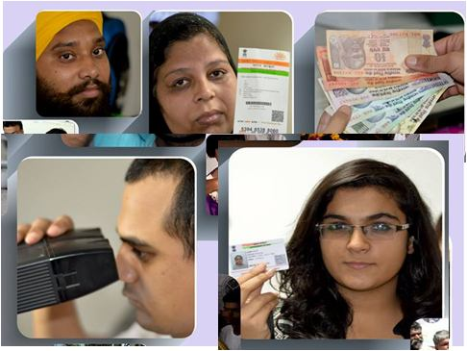
4.6 UCL
What Is UCL?
UCL stands for Update Client Lite. UIDAI developed software through which a resident can update His/her Demographic data and other Information
Demographic Data:
Name
Address
Age/DOB
Gender
Mobile
Email
Other Information
Photograph
Information sharing disclosure
Local language
Benefits of UCL
Through UCL you can Update any Demographic Record within 24 Hours
Resident can Update his data Demographic details and Photograph only
Each Update Cost only 25 Rupees
TAX - Rs. 3.81
VLE Share 80% - 16.95 (including TDS)
Wallet Deduction – 08.90

Slide 29
HARDWARE REQUIREMENTS
Laptop Specification
1. 2Ghz,Dual core or later
2. 3GB RAM or higher
3. 160GB HDD
4. Dedicated USB 2.0 Port(minimum 5 ports
5. Note: (Windows Vista/any 64 bit Operating System is not supported)
Latest Java should be installed
Single Fingerprint Device Model
1. Morpho - MSO 1300
2. Secugen
3. 3M CSD 200i
4. Mantra MFS 100
Pre-Requisites
• Administrator should have the 3 digit Registrar Code provided by UIDAI
• Administrator should have the 4 digit Enrolment Agency Code provided by UIDAI
• Administrator should have the Station ID to be assigned to the system
• Administrator should have the Enrolment agency specific user name and password to register the enrolment client.
The enrolment client/UCL users (operators/supervisors) should have applied for an UID
Administrator should need Document verifier, who is a government retired person of Class C & above
Administrator should have corresponding windows login created in the system
System should be connected to Internet.
Verifier required for Documents checking
Resident must be enrolled earlier in Aadhaar process for UCL
How does UCL Work?
Update Request: This tab helps to fetch the resident information upon single fingerprint (any finger) authentication of resident.
Demographic: This tab helps operator to edit and update demographic information of resident & information sharing consent.
References: This tab imposes operator to upload documents of proof based upon the updates made to resident’s information.
Photograph: This tab is optional and used to update photographs of resident.
Review: This tab helps operator to check the changes made on the resident’s information before confirmation.

Slide 30
Manual Guide:
https://drive.google.com/file/d/1s12GxM5q_jpX3VE-dsvVMCpIjGaeiLvm/view?usp=sharing
Point of Contact:
Name | Designation | Email Id | Contact
Gaurav Chauhan | Manager | gaurav.chauhan@csc.gov.in | 9910345930
Avnish Tyagi | HOD | avnish.tyagi@csc.gov.in | 9910066106

Slide 31
4.7 Digital Seva Kendra(DSK)
DSK stands for Digital Seva Kendra. CSC has started DSK to provide digital services easily to urban citizens. Although, we provide Aadhaar service in most of states through VLEs but it seems very difficult to provide these services in urban areas. Therefore, CSC started DSK mainly with a focus on urban areas for providing services easily.
CSC hires operators for different areas and provides them all devices related to the service within government premises.
Necessary information about centre and operator: -
Centre selection:
Centres will be opened at government premises as per the guidelines of UIDAI.
Written approval from the government department required (Annexure-I).
Room, electricity, Internet, Table, Chair etc will be provided by the department.
Operator and Hardware will be managed by CSC SPV.
Eligibility Criteria for Operator:
The candidate must be between the age group of 18-30 years.
If the candidate wants to apply as a DSK Operator in CSC, he / she need to be
10 +2 pass.
The candidate must have NSEIT certificate as Aadhaar Supervisor.

Slide 32
Documents of Operators
Voter ID Card/Aadhaar Card as POI (proof Of Id).
Aadhaar Card as a POA (Proof Of address).
Bank Pass Book First page/ Cancelled cheque.
PAN No. / Acknowledgement slip of apply for.
Resume
State will share the offer letter with Operators after that credentials being activated by UIDAI.
Centre Deployment:
Needs to coordinate with HO to bring the hardware for the centres.
Centre should be well promoted before opening.
Invite media and Local newspapers in inauguration.
Centre details of active centre will be entered in MIS.
Manual Guide:
https://drive.google.com/file/d/16YeSHIxQyJIXhbHUszeJDjtxeM0vAPRr/view?usp=sharing
Point of Contact:
Name | Designation | Email Id | Contact
BhavnaSaraswat | Executive | Bhavna.saraswat@csc.gov.in | 7060051932
Gaurav Chauhan | Manager | gaurav.chauhan@csc.gov.in | 9910345930
Avnish Tyagi | HOD | avnish.tyagi@csc.gov.in | 9910066106

Slide 33
4.8 UJALA
The initiative is part of the Government of India’s efforts to spread the message of energy efficiency in the country. UJALA scheme aims to promote efficient use of energy at the residential level; enhance the awareness of consumers about the efficacy of using energy efficient appliances and aggregating demand to reduce the high initial costs thus facilitating higher uptake of LED lights by residential users.
For operations kindly refer enclosed process manual.
Major Roles to be played by all VLE’s under this Services:
• Procurement of Ujala products through Digital Seva Portal.
• Sale of Ujala products as per the listed MRP.
• Mandatory entry of the product issuance to each customer. This data will be required to process VLE payment.
• VLEs who have received stock, have to punch on Digital Seva Portal.
Ujala Products financials
S.No | Product | MRP | VLE Commission | TDS | Net VLE Commission
 |  |  | (Exclusive GST)
1 | LED-Bulb | 70 | 4 | 0.2 | 3.8
2 | *LED- Tube light | 220 | 9 | 0.45 | 8.55
3 | *Fan | 1200 | 37 | 1.85 | 35.15

Slide 34
Manual Guide:
http://118.185.194.112/newsletter/images/User%20Manual%20for%20UJALA%20Products_V1.0.pdf
Point of Contact:
Name | Designation | Email Id | Contact
Vivek Chand Baloria | Manager | vivek.chand@csc.gov.in | 9971479002
Mayank Rawat | General Manager | mayank.rawat@csc.gov.in | 9811645178
Avnish Tyagi | HOD | avnish.tyagi@csc.gov.in | 9910066106

Slide 35
4.9 LED MMU
CSC PROMOTES LED BULB MANUFACTURING UNIT IN PURSUIT OF ITS MISSION TO CREATE ECOVILLAGES.
CSC SPV launched the service for LED Bulb Manufacturing to achieve our mission of converting rural villages into “LED Villages”.
Our aim is to create 100 such villages in year 2017.
BENEFITS OF CSC LED BULBS:-
LED products of CSC lasts longer because no ballast is required to ignite the bulb. Solid-state technology means that all light is generated electronically, eliminating the need for a physical spark. This means that less parts of the fixture can break, further reducing maintenance time. LED driver is so strong that can manage the high and low voltages in the Villages.
LED usage among our VLEs is on a steady increase in the light of Digital India and LED Village project. We will also help VLEs to get following registrations for their LED Setups:
Details of the units with the information: Manufacturing Units introduce by CSCSPV at an affordable price

Slide 36
A. TYPE LED MMU
Pro LED MMU Unit
Basic LED MMU Unit
Small Kit for Home Use
LED Raw Material
LED light bulbs can be used anywhere to save energy and money. Available in a variety of shapes and sizes, these high-quality LED bulbs utilize state-of-the-art, high-performance technology and extremely durable.
Video Guide:
https://www.youtube.com/watch?v=qNEUJfkZcIQ
Point of Contact:
Name | Designation | Email Id | Contact
Ankit Dhingra | Executive | ankit.dhingra@csc.gov.in | 9999053747
Ritu |  | csc.solar.ritu@gmail.com
Gaurav Kumar | Manager- Admin | gaurav.choudhary@csc.gov.in | 9654208221
Kumar Pushpendra | General Manager | kumar.pushpendra@csc.gov.in | 9540007929
Avnish Tyagi | HOD | avnish.tyagi@csc.gov.in | 9910066106

Slide 37
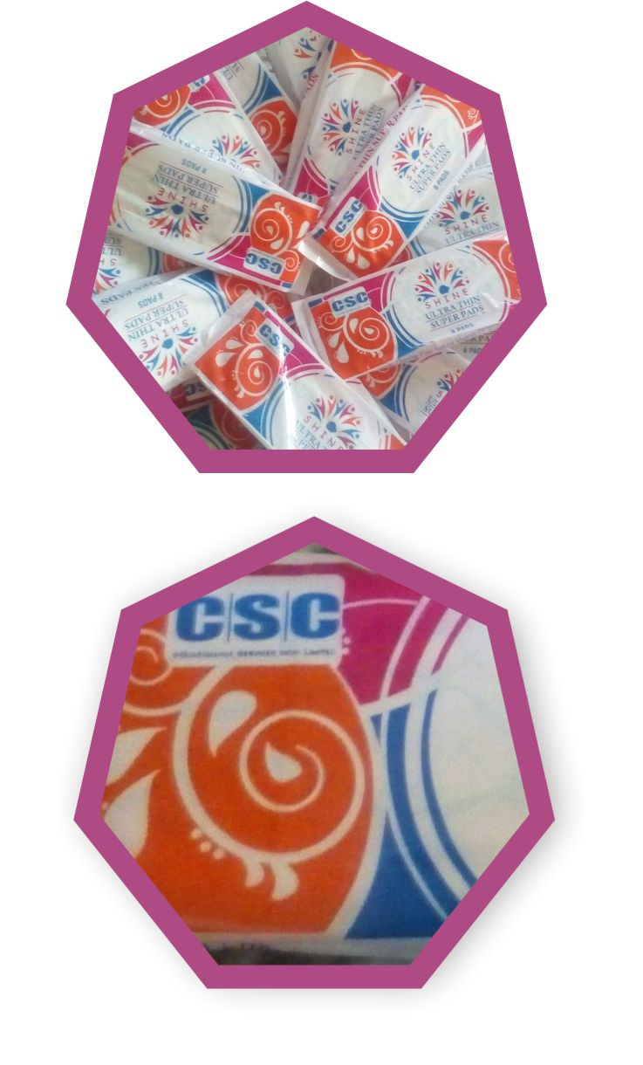
4.10 Sanitary Napkins
CSC SPV SANITARY NAPKIN assembling UNIT
CSC SPV has launched first of its kind MMU unit at their CSC Kendra in Telengana State. This MMU unit aims to assemble and manufacture sanitary pads for women’s, almost 15 women’s VLE are working it.
Only 12% of India’s 355 million menstruating women use sanitary napkins and approximately 88% of Indian women are using clothes, archer and husk sand.
CSC SPV aims to encourage and increase awareness among women to use sanitary pads, by “Creating awareness of menstrual hygiene”
The main Agenda of Unit Setup:
Women Hygiene in India
Following the Traditional approach till date
Earning their livelihood in their house.
A growth rate of over 25% to 45% is expected in India for the sanitary napkins market, which holds a huge potential and excellent profit margin for the assembling.

Slide 38
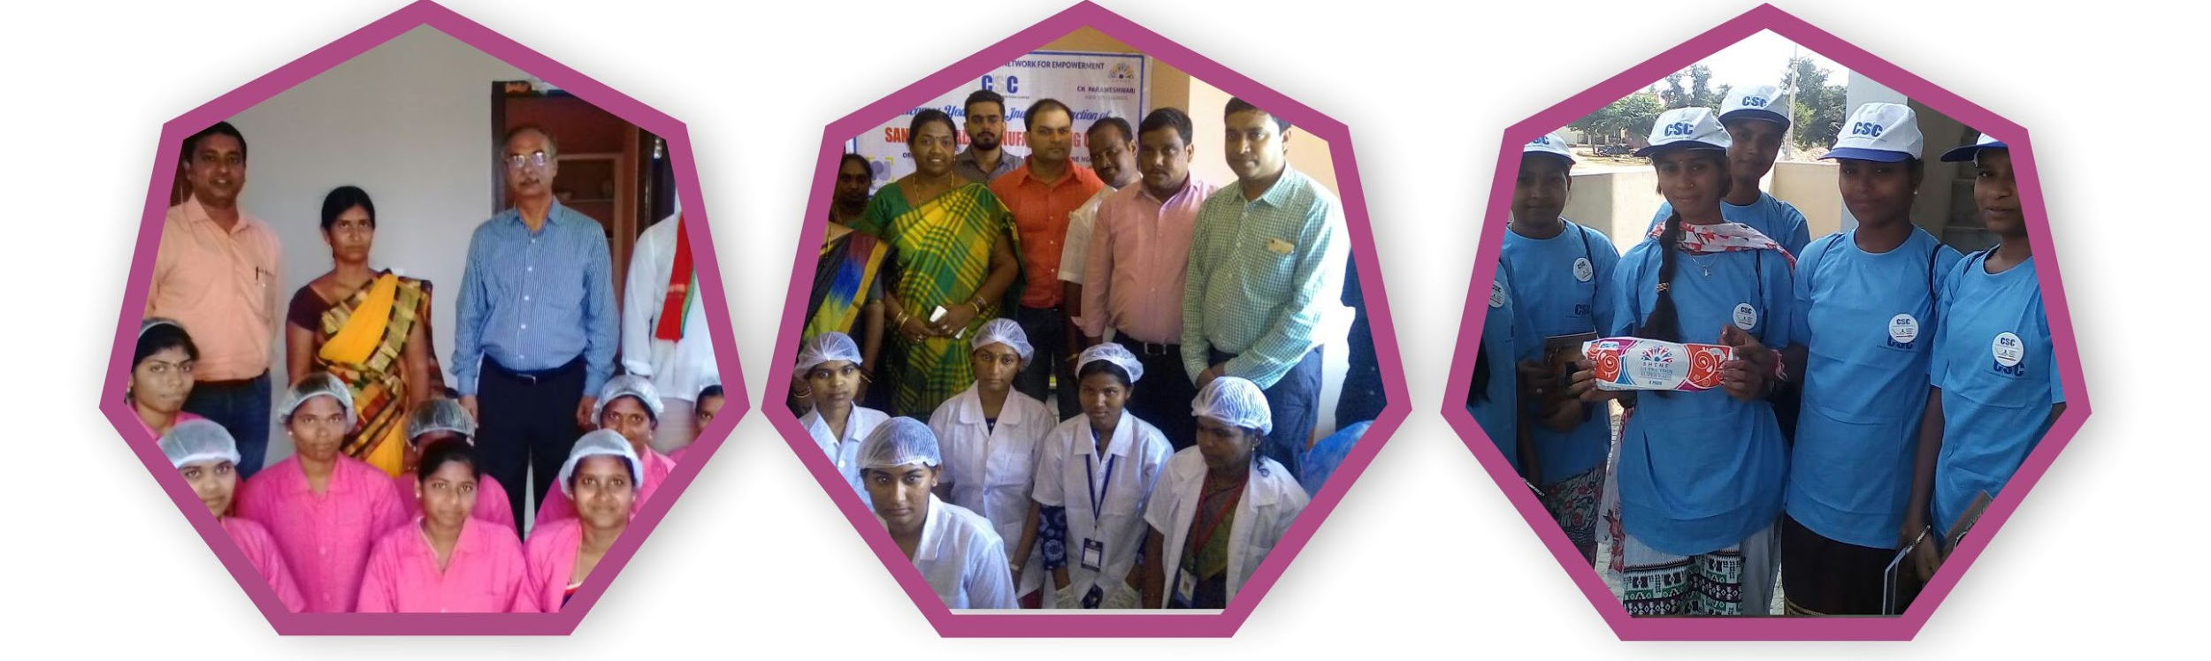
Point of Contact:
Name | Designation | Email Id | Contact
Ankit Dhingra | Executive | ankit.dhingra@csc.gov.in | 9999053747
Ritu |  | csc.solar.ritu@gmail.com
Gaurav Kumar | Manager- Admin | gaurav.choudhary@csc.gov.in | 9654208221
Kumar Pushpendra | General Manager | kumar.pushpendra@csc.gov.in | 9540007929
Avnish Tyagi | HOD | avnish.tyagi@csc.gov.in | 9910066106

Slide 39
4.11 Railway Ticketing (IRCTC)
CSC e-Governance Services India Limited is delivering various IRCTC services through the Common Services Centre Network pan India. Till August 2017, total 28,220 CSCs delivering service across the country.
Video Guide:
https://www.youtube.com/watch?v=-XMNkHgusLo
Point of Contact:
Name | Designation | Email Id | Contact
Devesh Kumar | Executive | devesh.kumar@csc.gov.in | 9654039667
Nutan Kumar | Executive | spinzer06@gmail.com | 9818319317
Sandeep Kumar Attri | Sr. Executive | sandeep.attri@csc.gov.in | 9911267927
MohdWasif Ali | Sr. Executive | Wasif.ali@csc.gov.in | 9810283160
Soumi Banerjee | AVP | soumi.banerjee@nic.in | 9811411268

Slide 40
4.12 Passport Applications
The Ministry of External Affairs, along with CSC e-Governance Services India Limited, has launched Passport related services through the vast network of Common Services Centres (CSCs) across rural hinterland.
The CSCs facilitate filling and uploading of Passport application form, payment of applicable fee (through debit/credit card or through SBI internet banking/challan mode) and scheduling of appointment for the visit to the Passport Seva Kendra (PSK) at nominal charge not exceeding Rs. 100/-. As per the appointment schedule, an applicant visits the PSK for completion of application submission process (including collection of digital photographs/ biometrics, verification of supporting documents and approval).
Video Guide:
https://www.youtube.com/watch?v=5s1evXzauZ8
https://www.youtube.com/watch?v=4in-7RBC9T4
Point of Contact:
Name | Designation | Email Id | Contact
Devesh Kumar | Executive | devesh.kumar@csc.gov.in | 9654039667
Nutan Kumar | Executive | spinzer06@gmail.com | 9818319317
Sandeep Kumar Attri | Sr. Executive | sandeep.attri@csc.gov.in | 9911267927
MohdWasif Ali | Sr. Executive | Wasif.ali@csc.gov.in | 9810283160
Soumi Banerjee | AVP | soumi.banerjee@nic.in | 9811411268

Slide 41
4.13 Education
Education Services leverage Information and communication Technologies to create awareness and empower citizens on digital technologies, financial management, and legal rights and facilitate educational services in rural areas.
Tally Certification:
Tally Certified Program is a transaction service CSC has launched through Digital Seva Portal. It will be an online process, where candidate have to choose one correct answer from the given options.
eLegal Consultancy:
Citizens particularly in rural locations are not aware about legal entitlements which the constitution has provided. As a result of this they are trapped in various legal cases and they are also not aware with whom to discuss the matter.
In order to reduce the gap and provide legal help, CSC SPV collaborated with National University of Juridical Sciences (NUJS) to provide e legal consultancy through pool of lawyers using the platform of CSCs spread across India. The service seeks to provide legal consultancy to citizens though the CSCs present in rural locations at their doorsteps.

Slide 42
Open Schooling:
The National Institute of Open Schooling (NIOS) and CSC SPV joined hands to make CSCs as NIOS Facilitation Centres. Under this partnership, CSCs can promote the Open Schooling in Rural India, Register Students, Pay Registration and Examination Fee; Know the Status of Admission, and Declare Results.
Khan Academy:
Khan Academy is an NGO working to provide world-class education absolutely free of cost. Anyone can visit their website and register as a student, parent or teacher and begin their learning journey.
IIT/JEE/BITSAT/NEET Preparation:
CSC VLEs have the chance of a lifetime to participate in selling India’s best product for IIT and Medical entrance exams. This product will be available for all exams across India including Board exams. This product is the best in the country. It guarantees score improvement without study by pointing out careless mistakes and other reasons why students lose marks. This is without even increasing knowledge.
FREE Education (PMGDISHA/Cyber Gram Yojana/ English Speaking Source)
PMGDISHA: Pradhan MantriGramin Digital SakshartaAbhiyaan is the scheme to make six crore persons in rural areas, across States/UTs, digitally literate, reaching to around 40% of rural households by covering one member from every eligible household. The Scheme would empower the citizens in rural areas by training them to operate computer or digital access devices (like tablets, smart phones etc.), send and receive e-mails, browse Internet, access Government services, search for information, undertake digital payment etc.
And hence enable them to use the Information Technology and related applications especially Digital Payments to actively participate in the process of nation building. The Scheme aims to bridge the digital divide, specifically targeting the rural population including the marginalised sections of society like Scheduled Castes (SC) / Scheduled Tribes (ST), Minorities, Below Poverty Line (BPL), women and differently-abled persons and minorities.

Slide 43
Cyber Gram Yojana: Multi-sectoral Development Programme (MsDP) aims at improving the socio-economic conditions of minorities and providing basic amenities to them for improving the quality of life of the people and reducing imbalances in the identified minority concentration areas.
As we are living in a digital society, it is felt that to achieve the objective of programme, it is necessary to equip the targeted group with knowledge of Information and Communication Technology (ICT) and enabling them to use ICT services in their day to day work. This will bring them greater access to information and new forms of social interaction and cultural expression which ultimately leads to achieve objective of programme. The Cyber Gram initiative under Multi- sectoral Development Programme is an effort in achieving this target.
CCC / CCC+:
These courses are designed to aim at imparting a basic level IT Literacy programme for the common man. This programme has essentially been conceived with an idea of giving an opportunity to the common man to attain computer literacy thereby contributing to increased and speedy PC penetration in different walks of life.
After completing the course the incumbent should be able to the use the computer for basic purposes of preparing his personnel/business letters, viewing information on internet (the web), receiving and sending mails, preparing his business presentations, preparing small databases etc. This helps the small business communities, housewives, etc. to maintain their small accounts using the computers and enjoy in the world of Information Technology. This course is, therefore, designed to be more practical oriented.

Slide 44
Super 30 (Books/Sample paper):
CSC SPV has collaborated with iScholar i30 for providing the IIT-JEE and engineering entrance exam coaching through Apna CSC. Considered one of the toughest exams, less than 1% succeeds due to the enormous syllabus, constantly evolving paper setting patterns and ever increasing cut-off percentages.
Legal Literacy Programme:
Legal literacy is seen as a tool to bring change at the grassroots level. The project aims to spread legal literacy and awareness related to rights by conducting sessions by gathering 40 participants fromneighbouringareas. It also strengthens rural people so that they know and understand the primary levels of laws recognize them and challenge injustices much more forcefully.
Tele – Law:
Department of Justice and CSC e-Governance Service India Limited for mainstreaming legal aid to the marginalised communities through Common Services Centre (CSC). Tele-Law means the use of communications and information technology for the delivery of legal information and advice.
This e-interaction between lawyers and citizens would be through the video-conferencing infrastructure available at the CSCs. The concept of Tele-Law is to facilitate delivery of legal advice through a panel of lawyers stationed at the state Legal Services Authorities (SALSA) and CSC. The project initiates to connect citizens with lawyers through video conferencing facilities by the Para-Legal Volunteers stationed at identified 1800 panchayat.

Slide 45
Investor Awareness Programme (IAP):
The ‘Investor Awareness Programme’ (IAP) is conceived to educate the prospective rural investor so that they understand the benefit of saving, investment and capital formation/ accumulation. The objective of this project is to enable CSCs to become Investor Education Hubs by hosting awareness sessions focused on the rural investor. The project is rolled out in collaboration with Ministry of Corporate Affairs.
NIELIT Facilitation Centre:
NIELIT(National Institute of Electronics and Information Technology), CCC and BCC Courses. DOEACC is the joint Scheme of Ministry of Information Technology (Department of Electronics) and All India Council for Technical Education (AICTE). AICTE is a statutory body for the development of technical education, which includes computer education, in the country.
The Scheme is administered by the DOEACC Society, an autonomous body of the Ministry of Information Technology, Government of India. The objective of the Scheme is to generate quality manpower in the area of Information Technology (IT) at the national level, by utilizing the facilities and expertise available with the training institutions/ organizations in the non-formal sector. Under the Scheme, computer training institutions/organizations in the non-formal sector are granted authorization for conducting specified Levels of courses, subject to their meeting well defined norms and criteria.
Video Guide:
https://www.youtube.com/watch?v=JZPHoFV91jY
https://www.youtube.com/watch?v=LT9qeLpfjRI
https://www.youtube.com/watch?v=QTDqB6DgyXw
https://www.youtube.com/watch?v=S6RCBd09Wgw

Slide 46
Point of Contact:
Name | Designation | Email Id | Contact
Deepak Kumar Sharma | Executive | deepakkumar.sharma@csc.gov.in | 9350030013
MeghaShirwan | Executive | megha.shirwan@csc.gov.in | 8130430610
Monika | Executive | monika.singh@csc.gov.in | 9958156090
ShahidParvez | Executive | zahidkhan454@gmail.com | 8826265249
Ravinder Singh | Executive | ravinder.singh@csc.gov.in | 8803780781
Swati Asati | Executive | swati.asati@csc.gov.in | 9977250894
Pradeep Singh | Senior Executive | pradeep.singh@csc.gov.in | 8750160831
Rohan Choudhary | Senior Executive | rohan.chaudhary@csc.gov.in | 8447526588
Sonu Kumar | Senior Executive | sonu@csc.gov.in | 9027816936
Urvashi | Senior Executive | urvashi.tyagi@csc.gov.in | 8588015081
Varsha | Senior Executive | varsha@csc.gov.in | 9971421113
Gunjan Singh | Senior Executive | gunjan.singh@csc.gov.in | 9718289123
Manmeet Kaur | Senior Executive | manmeet.kaur@csc.gov.in | 8860424121
Pranav Ranjan | Senior Executive | pranavranjan@gmail.com | 9650301266
Satyendra Singh | Senior Executive | Satyendra.singh@csc.gov.in | 9873264367
ShamitaDey | Senior Executive | shamita.dey@csc.gov.in | 9953891910
Tripti Jain | Senior Executive | tripti.jain@csc.gov.in | 9868630121
Varun Chauhan | Senior Executive | varun.chauhan@csc.gov.in | 9873440236
Vishvom Tyagi | Senior Executive | vishvom.tyagi@gmail.com | 9897196962

Slide 47
Vikash Kumar | Senior Executive- Legal | kumar.vikash83@nic.in | 9891824472
Adarsh Nigam | Assistant Manager | adarsh.nigam@nic.in | 9599373593
MubashirLatief | Assistant Manager | mubashir.sofi@nic.in | 9015920257
Suman Pokhriyal | Assistant Manager | suman.pokhriyal@csc.gov.in | 9811483686
Surbhi Sharma | Assistant Manager | surbhi.sharma@csc.gov.in | 9899592290
BhagwatiJamnal | Manager | bhagwati.jamnal@csc.gov.in | 9654034882
Omveer | Manager | omveer@csc.gov.in | 8447491161
Lay SmrityGuria | Senior Manager | smriti.lay@csc.gov.in | 8860470684
Shahnawaz Rashid | General Manager | shahnawaz.rashid@csc.gov.in | 9796785559
Subodh Mishra | AVP | subodh@cscegovindia.com | 9871230717
RishikeshPatankar | HOD | rishikesh@csc.gov.in | 9868019788

Slide 48
4.14 Health Care Services
CSC Healthcare Services endeavours to provide holidtic & affordable healthcare solutions to the masses in rural and remote areas of the country, through one stop shop delivery points i.e Common Service centers.
CSC aims to bridge the need Vs demand gap by providing assisted digital access to basic healthcare facility to save time, money ,efforts & energy. CSC is offering all the services to rural india at affordable rates, using “Digital Seva transaction portal.
Service Access process flow:
VLE will login to digital sevaportal using his 12digit login ID & password
Will click on healthcare from the top right service icons
WIll click on the service he wants to deliver at his CSC
Will register the patient in accordance to the service requirement
will pay from his wallet for the desired service

Slide 49
Healthcare service list
Tele-medicine
ATHS
General Physician Consultation
Super Speciality Consultation
CSC Telemedicine platform
General Physician Consultation
Ayurveda tele-consultation
Homeopathy Tele consultation
Tele-diagnostic
Hello Health – Basic Vitals
Ring MD Eye testing
Thyrocare – Blood Testing
Medi-360
Tele- Pharmacy
1 mg (Ayush & OTC)
JIVA (Ayurveda)
Welcome cure (Homeopathy)
Jan Aushadhi
Products
Training
Telemedicine Health operator - ATHS
Venipuncture - VIVO
Assistant Pharmacist - BSS

Slide 50
Healthcare Services delivery through CSC
Tele-medicine
(Video Interaction of a patient with doctor)
Diagnostics
(Indicative basic diagnostic test)
Medicines
(Generic medicines
Prescription based medicine delivery for Allopathy and Homeopathy)
Health Products
(Ayurvedic and OTC products)
Homoepathy Health Plans
Video Guide:
https://www.youtube.com/watch?v=FVJWa_80qi4
https://www.youtube.com/watch?v=jK-NTE6ldtk
https://www.youtube.com/watch?v=SrYiwaJ4sHY

Slide 51
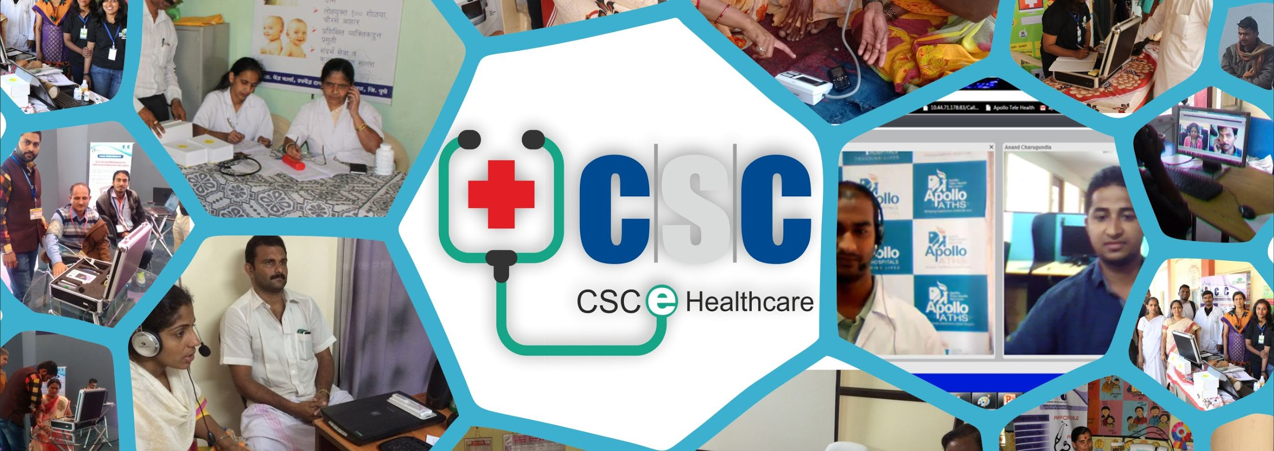
Point of Contact:
Name | Designation | Email Id | Contact
Mohd. Saleem | Executive- Health | mohd.saleem@csc.gov.in | 8750996998
VritiGamta | Executive- Health | vritigamta@gmail.com | 7982913624
Prabhnain Kaur | Assistant Manager | prabhnain.kaur@csc.gov.in | 9810834585
Archi Sharma | HOD | archi.sharma@csc.gov.in | 9953858698

Slide 52
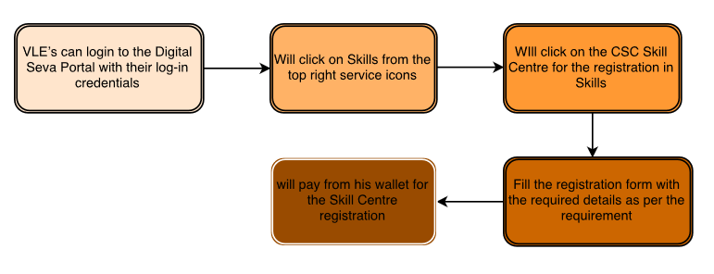
4.15 Skill Development
Skill India is an initiative of the Government of India which has been launched to empower the youth of the country with skill sets which make them more employable and more productive in their work environment. Our National Skill Mission is chaired by the Hon’ble Prime Minister, Shri Narendra Modi himself.
Skills Services Description
CSC Skill Centre-
Its great opportunity for VLEs to work in Skill Space by registering their CSCs as CSC Skill Centres. On successful registration VLE could avail the various services under Skill Development:

Slide 53
A) Government Scheme
a) Recognition of Prior Learning Scheme
b) Persons with Disability Scheme
B) Self-paid Courses
C) Learning Management System
Self-paid Courses-
CSC E-Governance Services India Limited has taken a unique initiative with the aim towards refining the skills of candidates so that they can enrol themselves in the course of their choice by own at any point of time. These are independent courses offered by the CSC SPV, no government scheme involved in these courses, focus on providing the skill training in the rural areas which can be locally accessed by the rural youth and get certified and become eligible for suitable employment opportunities in industries or start own business in their locality itself.
CSC with leading industry partners enables Learning & Skilling using CSC Skill Self Paid Courses, which are self-paced, interactive and virtually simulated using process simulation tools. This course/content is created with the help of industry experts having domain expertise &experience. The candidates may pay for the available courses and acquire new skills through CSCs. Training will be imparted in 14 different courses under this Programme.

Slide 54
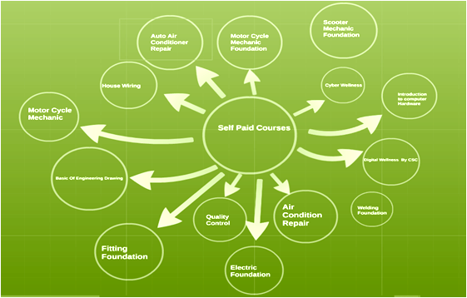

Slide 55
CAD Course-
CSC SPV has collaborated with SIEMENS to provide opportunities in field of advanced skills using Solid Edge CAD tool: A Siemens PLM Software. Get ready to solve real life design problems with streamline creation.
CAD software can be used to create two-dimensional (2-D) drawings or three-dimensional (3-D) models. CAD technology is used in the design of tools and machinery and in the drafting and design of all types of buildings, from small residential types (houses) to the largest commercial and industrial structures.
This software is used by architects, engineers, drafters, artists, and others to create precision drawings or technical illustrations. Computer-aided design is the use of computer systems to aid in the creation, modification, analysis, or optimization of a design.
CAD software is used to increase the productivity of the designer, improve the quality of design, improve communications through documentation, and to create a database for manufacturing. CAD output is often in the form of electronic files for print, machining, or other manufacturing operations.
Candidates become eligible after this course for jobs like: 2D CAD Draftsman, 3D Rendering Artist/Visualize, Interior Designer, CAD Draftsman Civil, Art Installation Designer, CAD Operator and CAD Counsellor.
Target Audience-- Candidates from ITI, Diploma, B. Tech and M. Tech background.
Sector/ Industry- Automobile/Architectural/Civil/Structural/Mechanical/Construction/Art & Design/ Training companies.

Slide 56
Video Guide:
https://www.youtube.com/watch?v=rTL6hBTAjlY
https://www.youtube.com/watch?v=U_1zwbTMhRc
https://www.youtube.com/watch?v=zWhU3CXq6wk
https://www.youtube.com/watch?v=c3ULeJAAArc
Manual Guide:
https://drive.google.com/file/d/15kOH-3eEgA5HKFmhqaWir3dScXwdT6kL/view?usp=sharing
Point of Contact:
Name | Designation | Email Id | Ext
Ashwani Tyagi | Senior Executive | ashwani.tyagi@nic.in | 9711665459
Arvind Rathi | Senior Executive | arvind.rathi@csc.gov.in | 9466226992
Amit Saini | Assistant Manager | amit.saini@csc.gov.in | 9871232125
Naveen Sharma | General Manager | naveen.sharma@csc.gov.in | 9355580091

Slide 57
4.16 CSC VLE Bazaar
The journey started in 2016 when IT Minister Shri Ravi Shankar Prasad purposed that government must take initiative in building up rural platform. Prime focus for VLE Bazaar is to emerge as a strong player in the rural market by carefully identifying gaps in the rural market and crafting the right product offering for consumers. Our mission is to help these artisans create sustainable livelihoods for their families through the sale of their unique crafts. We create economic opportunities for artisan groups around the country where livelihoods, communities, and craft traditions are marginal or at risk. We offer access to new markets, business training, eco-effective processes and design innovation through a network of partners to promote sustainable growth and community well-being.
The initiative will transform the practice of this culturally rich and marketable craft into a competitive and profitable economic activity, benefiting not only 2,000 women artisans directly, but also their families, communities.

Slide 58
Create profile at Vlebazaar
PROCESS FLOW FOR BUYING ON VLE BAZAAR
Browse the products
‘’Buy’’ your desired product
Choose your mode of payment & confirm order
Receive confirmation mail for your order

Slide 59
Process flow for being a seller on VLE Bazaar
Register on VLE bazaar
Apply as a Vendor
Manage your products/Orders on dashboard
Invoice will be generated as per order received
Ship the order to along with invoice and standard CSC logistics
Update the tracking ID and shipping status of order
Track delivery detail of order
When order delivered, change status to delivered
Online selling successful!!!

Slide 60
Video Guide:
https://www.youtube.com/watch?v=HGNhYqo26gI
https://www.youtube.com/watch?v=aGnXeC8LdCs
https://www.youtube.com/watch?v=4m-PAdbrRwg
Point of Contact:
Name | Designation | Email Id | Contact
Ayush Gupta | Executive | ayush.gupta@csc.gov.in | 8882942010
Antirpreet Singh | Assistant Manager | antirpreet.singh@nic.in | 9560977738
Sarthik Sachdeva | HOD | sarthilk.sachdeva@csc.gov.in | 9855531037

Slide 61
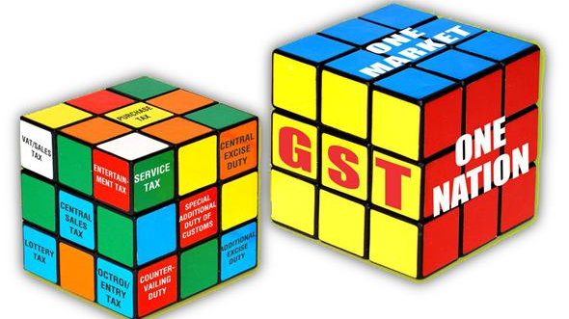
4.17 GST
With the implementation of Goods and Services Tax (GST) from 1st July 2017, all the Taxpayers are expected to file their periodic returns. CSC e-Governance Services India Limited has rolled out GST Return filing service through its network of more than 2.5 lakh Common Services Centers (CSC).
CSC SPV has built a filing application on Digital Seva Portal and a support function has been created to help the Village Level Entrepreneurs (VLEs) operating these CSCs across India in filing periodic returns of the Taxpayers.
VLEs can deregister for GST number if the turnover is less than 20 lakhs as the notifiication from Government of India specifies that the eCommerce operators having an aggregate turnover of less than Rs 20 lakhs/10lakhs (Special states) are not required to register under GST.

Slide 62
Video Guide:
https://www.youtube.com/watch?v=IPaqgco6hnA
https://www.youtube.com/watch?v=wwMxwEH940s
https://www.youtube.com/watch?v=U0Gg11IhIR4
https://www.youtube.com/watch?v=xenwzb4UZLU
Point of Contact:
Name | Designation | Email Id | Contact
Shivam Nagar | Executive – GST | Shivam.nagar@csc.gov.in | 9654920806
Shubhangi | Executive – GST | Shubhangi.jagdish@csc.gov.in | 8802024220
SonamSrivastva | Executive – GST | Sonam.srivastava@csc.gov.in | 7503902155
AmarjeetPardhi | HOD | amarjeet.pardhi@nic.in | 9971814455

Slide 63
4.18 Electricity Bill Payment
CSC e-Governance Services India Limited entered into agreement with various Electricity Distribution Corporations (Discoms) of States/Union Territories for collection of electricity consumption bills through CSC Network. Till September, 2017, system integration for payment of electricity bills through CSC network on Digital Seva Portal has been completed for 12 States and 3 Union Territories.
Video Guide:
https://www.youtube.com/watch?v=wPO4ZNrziO0
https://www.youtube.com/watch?v=JNKa85a44PY
Point of Contact:
Name | Designation | Email Id | Contact
Archana Gangwar | Trainee | archana@csc.gov.in | 9643197606
Ankit Chauhan | Executive | ankit.chauhan@csc.gov.in | 8285752332
Sefali Bharti | Executive | sefali.bharti@csc.gov.in | 8285752332
Alka Pandey | Senior Executive | alka.pandey@csc.gov.in | 9953415223
Ashutosh Kumar | Assistant Manager | ashutosh.kumar@csc.gov.in | 7042665562
Swati Tyagi | Assistant Manager | swati.tyagi@csc.gov.in | 9871140127
Sachin pal Singh | Manager | sachinpal.singh79@nic.in | 9760287973
Monidipa Sen | Manager- Logistics | monidipa@csc.gov.in | 9711870494
Rajesh Seth | HOD | rajesh.seth@csc.gov.in | 9810216196

Slide 64
4.19 Election
CSC SPV executed a MoU in 2013 with the Election Commission of India for delivery of various Electoral Registration Services through CSC Network pan India. To facilitate online services of Election commission to be rendered leveraging the network in all the States and Union territories of India are as follows.
Currently, the various services including forms and EPIC printing services are being provided in the states of Punjab, Haryana, Chhattisgarh, Bihar, Jharkhand, Gujarat, Tripura and Tamilnadu. It is proposed to integrate the CSC SPV portal with the central portal of the Election Commission of India so that the services could be rolled out in the other states also and made easily accessible to all citizen across the country
S No | Current Set of Service
1 | Application for Addition of Name in the electoral rolls
2 | Application for Deletion of Name in the electoral rolls
3 | Application for Modification of Name / other details in the electoral rolls
4 | Application for Transposition of Name in the electoral rolls
5 | Printing of EPIC card in color (New or Duplicate) at the CSC
6 | Search Services Name in Electoral Roll, Name of Polling Station, Status of Application , Status of Grievance etc.
7 | Registration of complaint

Slide 65
Video Guide:
https://www.youtube.com/watch?v=wPO4ZNrziO0
https://www.youtube.com/watch?v=JNKa85a44PY
Point of Contact:
Name | Designation | Email Id | Contact
Archana Gangwar | Trainee | archana@csc.gov.in | 9643197606
Ankit Chauhan | Executive | ankit.chauhan@csc.gov.in | 8285752332
Sefali Bharti | Executive | sefali.bharti@csc.gov.in | 8285752332
Alka Pandey | Senior Executive | alka.pandey@csc.gov.in | 9953415223
Ashutosh Kumar | Assistant Manager | ashutosh.kumar@csc.gov.in | 7042665562
Swati Tyagi | Assistant Manager | swati.tyagi@csc.gov.in | 9871140127
Sachin pal Singh | Manager | sachinpal.singh79@nic.in | 9760287973
Monidipa Sen | Manager- Logistics | monidipa@csc.gov.in | 9711870494
Rajesh Seth | HOD | rajesh.seth@csc.gov.in | 9810216196

Slide 66
4.20 Wifi Choupal
CSC Wi-Fi Choupal Services India Private Limited is a subsidiary incorporated under Companies Act 2013 by CSC e Governance Services India Limited, a special purpose vehicle (SPV) set up by Ministry of Electronics and Information Technology, Government of India to enable internet connectivity at Gram Panchayat.
To realize the vision of Digital India programme into digitally empowered society and knowledge economy CSC Wi-Fi Choupal was introduced to enable last mile delivery of internet connectivity through Wi-Fi/Wireless and bridge the urban rural divide.
CSC Wi-Fi Choupal initiative encapsulates enabling of Wi-Fi Service in 2.5 lakh Gram Panchayat by deploying low cost infrastructure thereby delivering services at an affordable price and reliable access of internet. CSC Wi-Fi Choupal makes requisite policy for facilitating internet service by integrating it with BharatNet end point/or any other service providers at Gram Panchayats (GP) providing last mile connectivity.
Wi-Fi Choupal essentially facilitates a Service Delivery ecosystem which can be used to deliver the following services:-
Hi Speed Internet Access across village
Free Wi-Fi calling solution
Video Calling between local Smartphone possible without using telecom billing
Streaming of Audio/Video Content (entertainment, edutainment and infotainment) over Smartphone and Tablets
Mobile Commerce

Slide 67
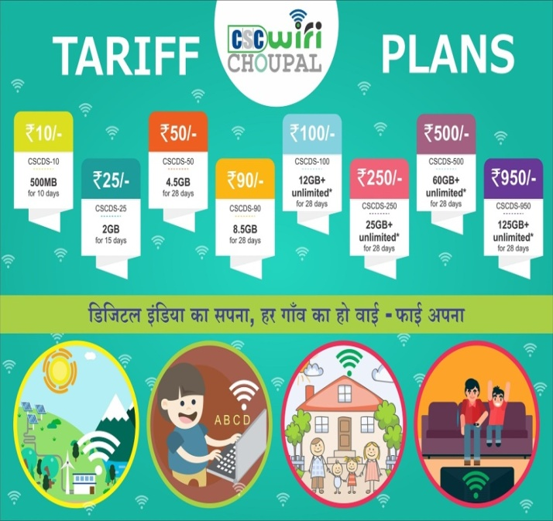
Video Guide:
https://www.youtube.com/watch?v=A15L516ayV8
https://www.youtube.com/watch?v=mnMQP_rQzV0
https://www.youtube.com/watch?v=C7Ckv37eI9A
Manual Guide:
https://drive.google.com/file/d/19anpXP8t83x3pEajsouK9SL2FJkjjQ9t/view?usp=sharing
Point of Contact:
Name | Designation | Email Id | Contact
Shivendra Singh | Executive | shivendra.singh90@nic.in | 9958706859
Vishal Batra | Executive | vishal.batra97@nic.in | 8571854229
Ashive Tyagi | Executive | ashive.tyagi@csc.gov.in | 9717276683
Jyoti Rani | Senior Executive | jyoti.rani@csc.gov.in | 7532030643
RishabhBhalaik | Assistant Manager | rishabh.bhalaik@csc.gov.in | 9971946425
Madhur Kumar | Assistant Manager | madhur.kumar@csc.gov.in | 9971875999
Gaurav Kumar | Project Manager | gaurav.k12@nic.in | 8468869333
Pankaj Dang | CTO | pankaj.dang@csc.gov.in | 9899976819
Abhishek Singh | COO | abhishek.singh@csc.gov.in | 9953858615

Slide 68
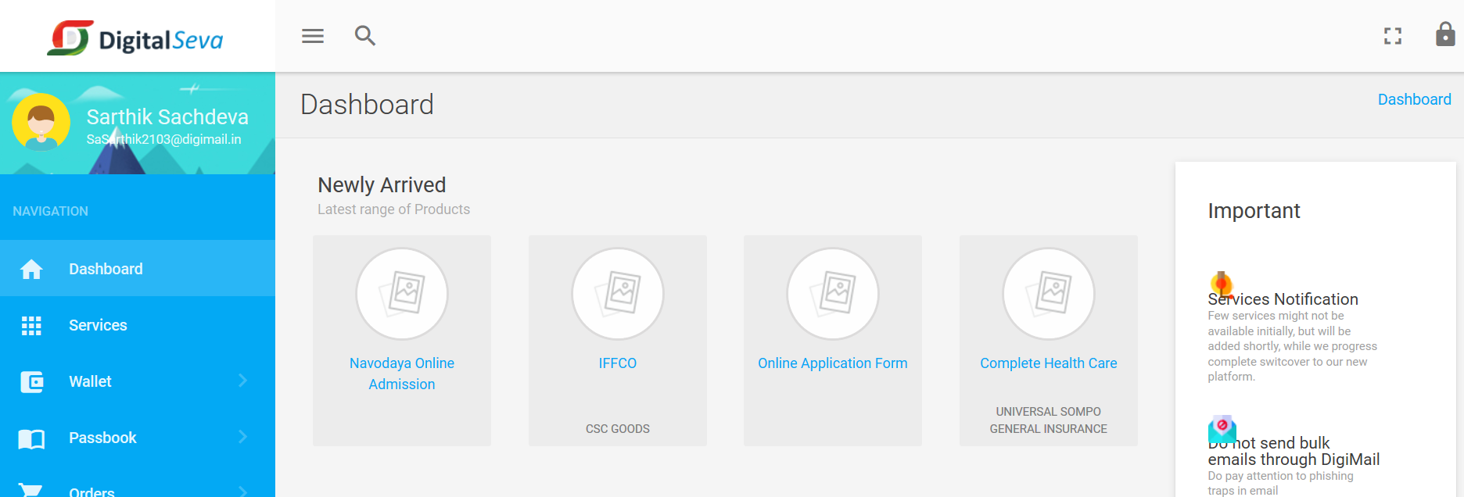
4.21 New Services
CSC SPV is taking necessary steps to increase the number of services on DigiSeva portal which can help VLEs to generate maximum revenue.
VLE can check the newly arrived services in the dashboard after login to digitalseva.csc.gov.in (as shown in the below screenshot). After the launch of new service a mail will be sent on Digi Mail along with the guide or manual. The information on new services will also published in Newsletters and in different whatsup groups.
All manuals guides or new services will also be avilable at below link;
http://vlebazaar.csc.gov.in/csc-manual

Slide 69
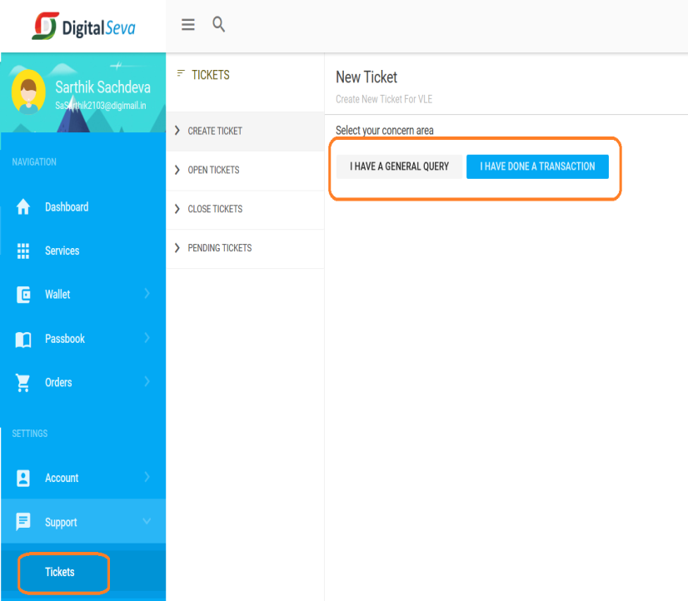
4.22 Helpdesk and Ticket Generation
For any problems or queries related to the portal, you may raise a ticket and we will ensure that you receive a solution of the same as described below:
Mention the appropriate “Subject” of the query and should be minimum 3 characters long.
Select the “Category” of which your query belongs to from the drop down.
Select the “Product / Service” of which your query belongs to from the drop down.
Write the descriptive description of the query/issue in the “Message” box. It should be minimum 12 characters long.
Click on “Submit”button to generate the ticket.
Incase of any further queries VLE can call from his registered Mobile number at 1800-3000-3468.
CSC SPV introduced Digital Seva Portal V2.0 (Beta) comes with enhanced features and more user friendly interface. VLE can check the new features of portal likeaccount details update, profile update and others at below links.
https://www.youtube.com/watch?v=Df2moGS1mzs&feature=youtu.be

Slide 70
THANK YOU FOR LISTENING
© CSC e-Governance Services India Limited
Ministry of Communications & Information Technology, Electronics Niketan,
3rd Floor, MeitY, 6CGO Complex, Lodhi Road, New Delhi - 110003

